Slide 1
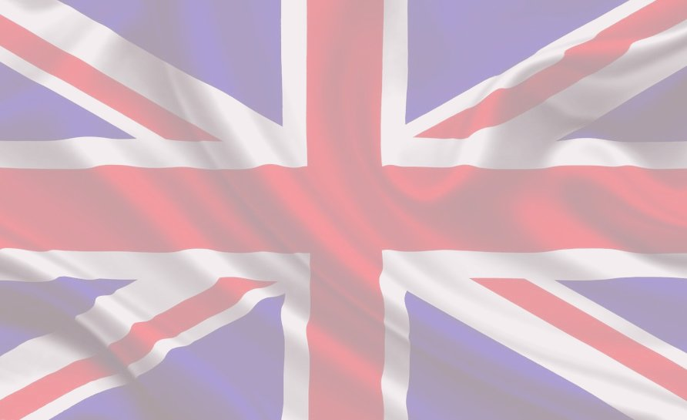

The United
Kingdom
Wykonawca; Kacper Skorek VD

Slide 2
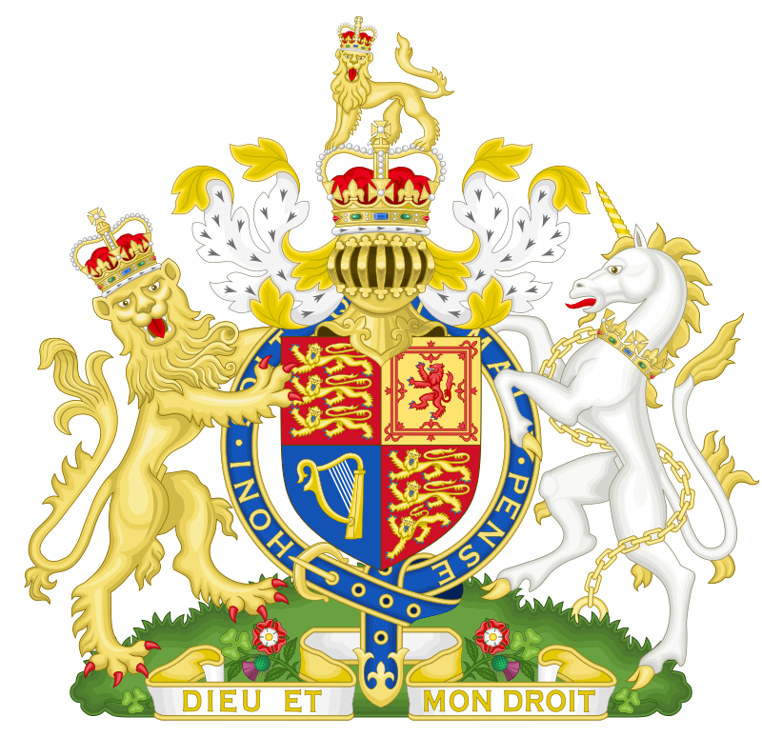
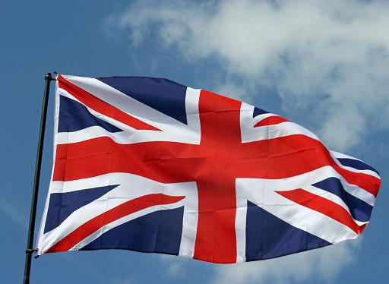
It is a flag and a coat of arms of the United Kingdom

Slide 3
Everybody know the British flag. Here are some facts about it.
The flag is called the Union Jack. There are three elements of the Flag:
The British cross of St. George
The Scottish cross of St. Andrew
The Irish cross of St. Patrick
The flag is from 1801.

Slide 4
There are four parts of the British coat of arms. Every element symbolise different nation.
There are three plants with the coat of arms. A rose symbolise England, a thistle – Scotland and a clover – Northern Ireland

Slide 5
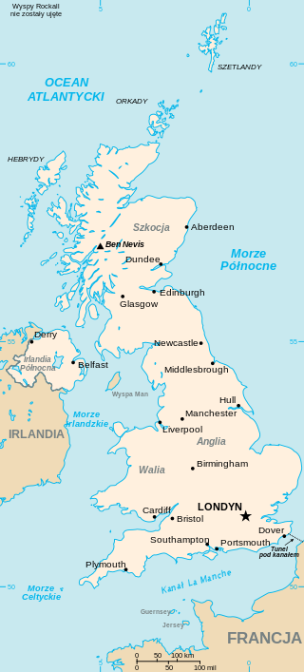

`
There are four parts of the United Kingdom: England, Scotland, Wales and Northen Ireland. It is one of the most important countries in the world. Many people in the world can speak English.

Slide 6
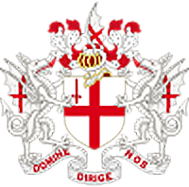


London is the capital of the United Kingdom. It is a very big city. Many people live in London.
It is a coat of arms of London

Slide 7
London
London had many names. First, it was called
Londinium. The Saxons named it Lundenwic. Then Alfred the Great called it „Lundenberg”.

Slide 8
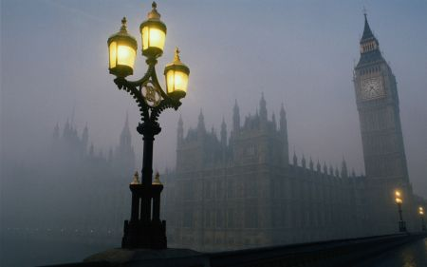
City lamps
London was the first city in the world with street lamps. The mayor of London Sir Henry Barton in 1417 put the lamps between Hallowtide and Candlemasse"

Slide 9
Brittish Holidays
St Valentines Day – St. Valentine was Brittish. He is a patron of lovers. The holidays is now popular in the whole world
Kissing Friday – it is on Friday after Ash Wednesday. On the day people kiss each other.
Queen’s birthday- Elisabeth II has two birthdays – on the 21st of April and national birthday in June The ‘official’ birthday is connected with army parade - "Trooping the colour"

Slide 10
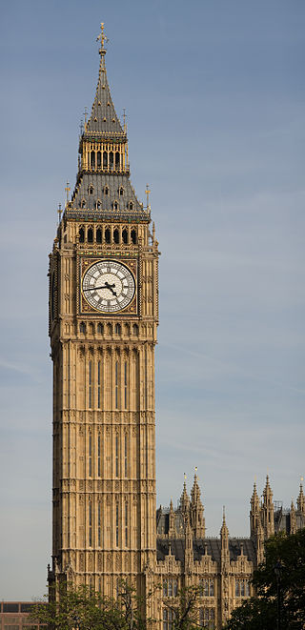
Tourist attractions
There are many tourist attractions in London. The most famous is Big Ben.

Slide 11
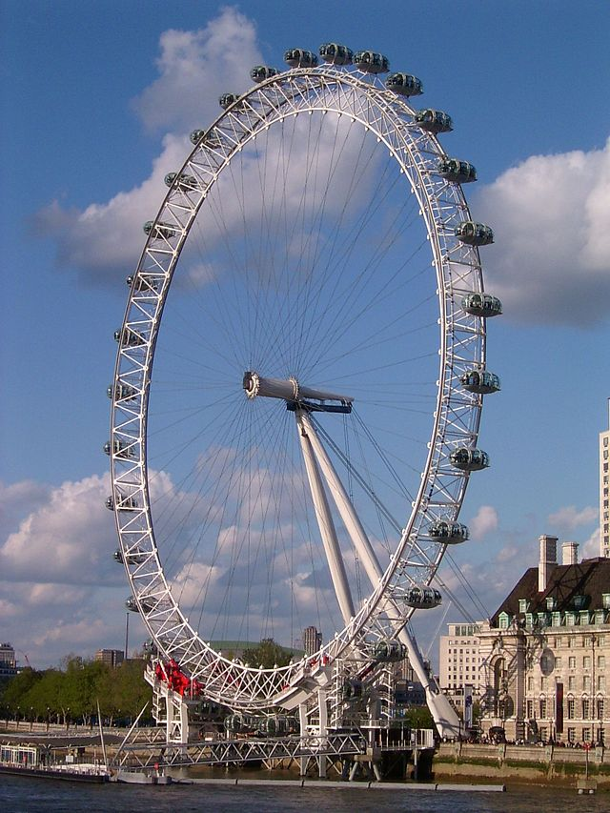
The London Eye
From the London Eye people can see the whole city

Slide 12
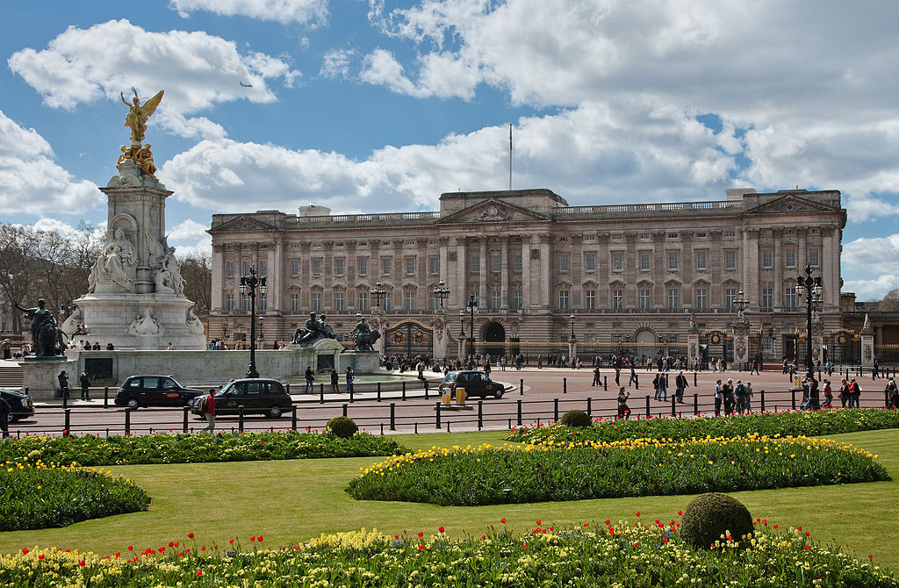

The Buckingham Palace
Qeen Elizabeth II lives in the Buckingham Palace. People can see the changing of the guards there.

Slide 13
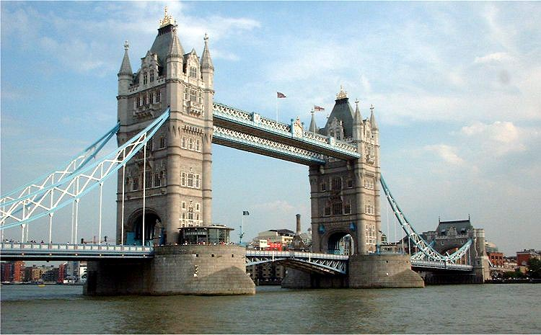

The Tower Bridge
It is the most famous bridge in the world.

Slide 14
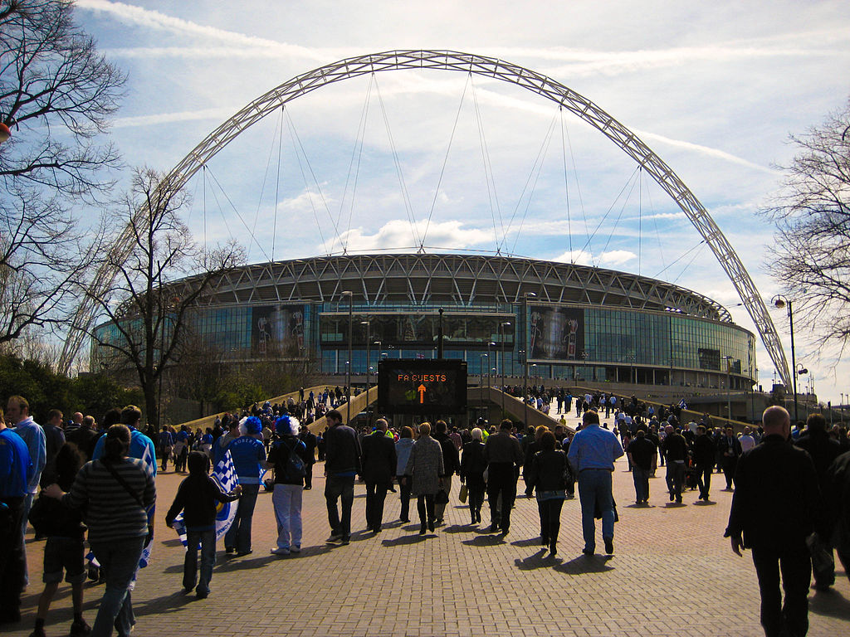
Wembley stadium
It is the second biggest stadium in Europe. There are 90 thousand seats in the stadium.

Slide 15
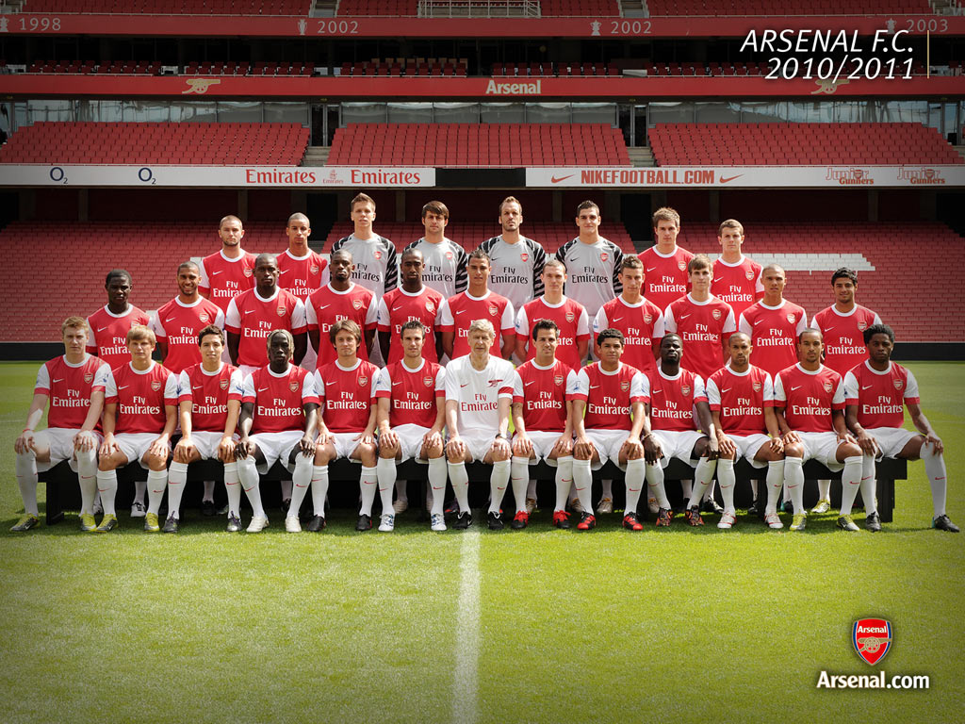
Arsenal London
It is one of my favourite teams. Polish goalkeeper Wojciech Szczesny plays there.

Slide 16
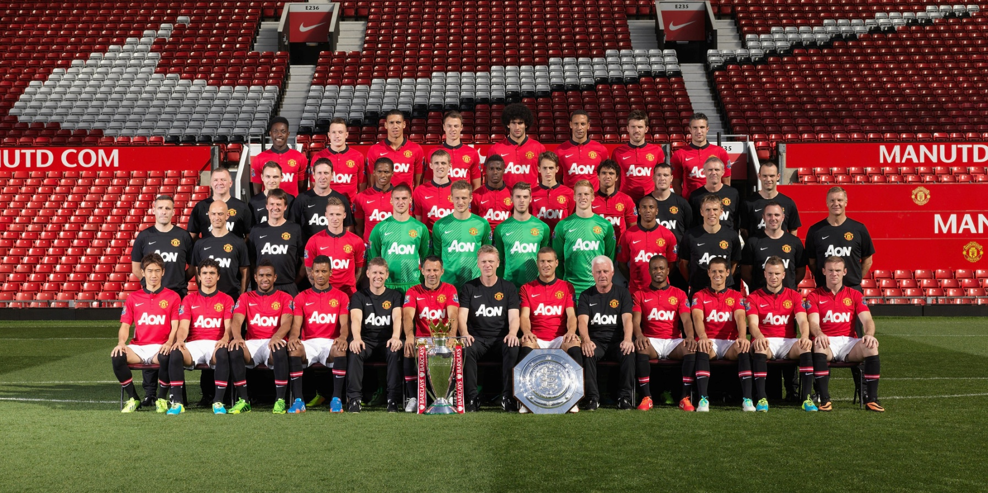

Manchaster United is the most famous English team in the world. Their stadium is called Old Trafford.

Slide 17

I thanks for look round my introduction.

Slide 18
The source
Wikipedia
Google grafika
English dictionary

