Slide 1
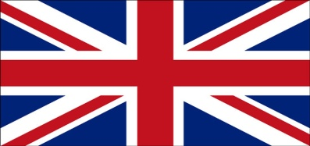

GREAT BRITAIN in my dreams
Jakub Leszczyński kl. VB

Slide 2
GREAT BRITAIN
It is an island nation located in Western Europe. The United Kingdom consists of England, Wales, Scotland and Northern Ireland. The United Kingdom is one of the major powers of the times. Its armed forces are stationed in 80 countries around the world. The country is also counted among the most influential in the European Union.

Slide 3
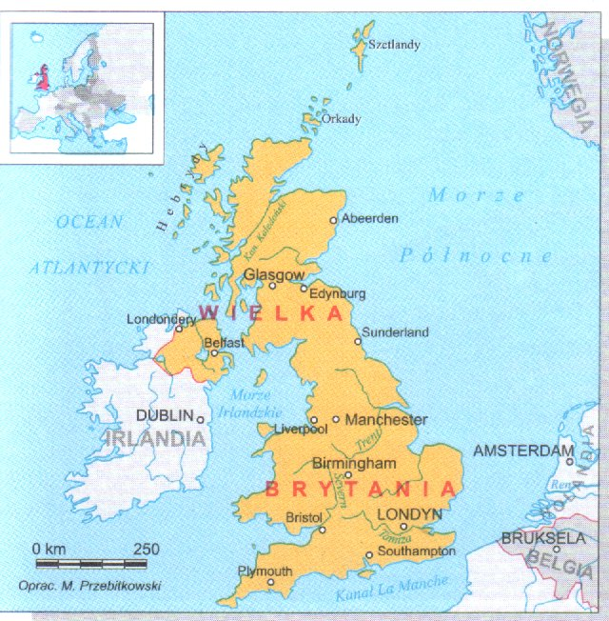
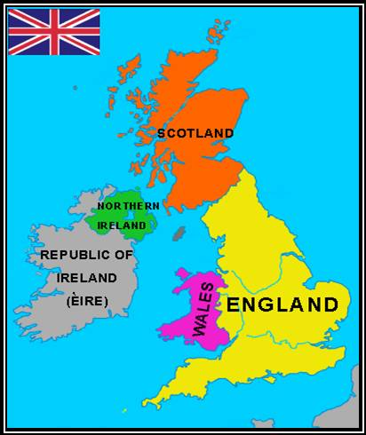
GREAT BRITAIN
Area: 244 100 km2
Length of coastline: 12 429 km
Regions: Southern England, East Anglia, Andlia Central, Northern England, Scotland, Wales, Northern Ireland

Slide 4
GREAT BRITAIN
The longest river: the Thames (Thames) (320 miles)
Population: 59.5 million
Capital: London
Government: Monarchy
Languages: English (official), Welsh, Irish, Gaelic (Scottish)
Currency: 1 pound sterling denoted by the symbol £ = 100 pence

Slide 5
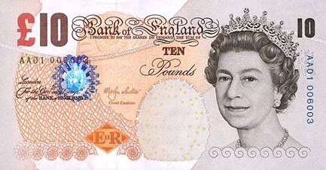
GREAT BRITAIN
Currency: 1 pound sterling denoted by the symbol £ = 100 pence

Slide 6
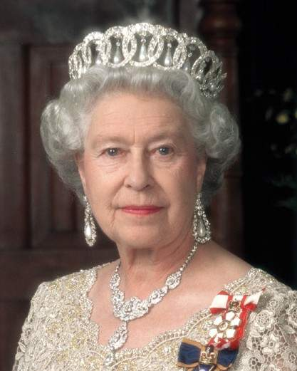
GREAT BRITAIN
The United Kingdom is a hereditary monarchy with a parliamentary government responsible to parliament - no constitution. The current British monarch is Queen Elizabeth II, who sat on the throne in 1952, and was crowned in 1953. Today, its functions are mainly ceremonial, with real authority rests in the hands of the Prime Minister.
Notes:
Ustr

Slide 7
GREAT BRITAIN
National Flag of Great Britain (called the Union Jack). British flag to some extent reflects the history of the country. Union Jack consists of three
crosses of three patron saints:
red on a white background is the cross of St. George - the patron saint of England (revered April 23)
white diagonal cross on a blue background is a cross of St. Andrew - the patron saint of Scotland (celebrated on November 30)
red diagonal cross on a white background is the cross of St. Patrick - the patron saint of Ireland (revered March 17)

Slide 8
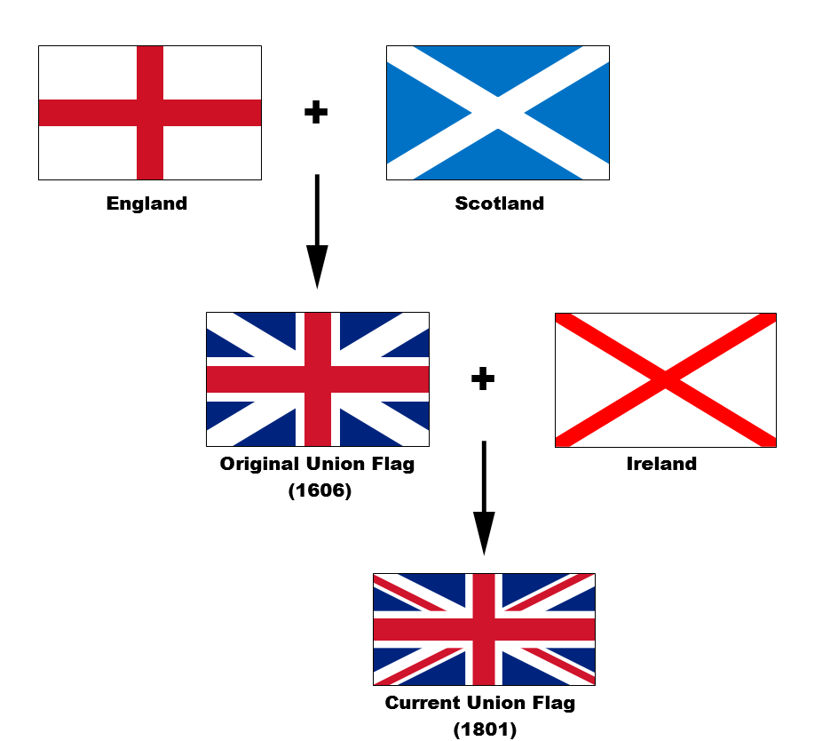
GREAT BRITAIN

Slide 9
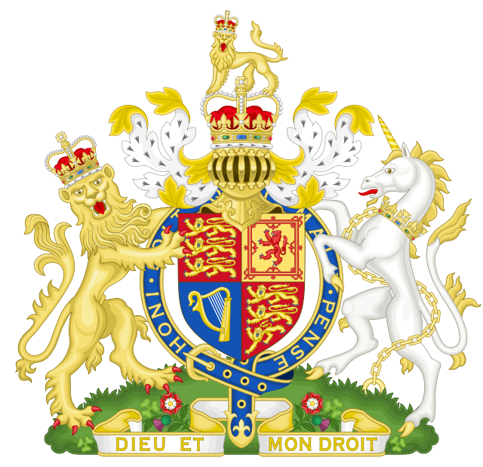
GREAT BRITAIN
HERB OF GREAT BRITAIN

Slide 10
GREAT BRITAIN
The United Kingdom consists of:
unit | capital | population | The official language
England | London | 50 095 000 | English
Scotland | Edinburgh | 5 060 000 | English, Scottish
Wales | Cardiff | 2 952 500 | English, Welsh
Northern Ireland | Belfast | 1 710 000 | English, Irish

Slide 11
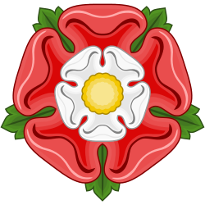
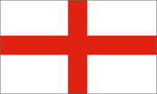
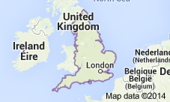
England
England - the largest and most populous constituent part of the United Kingdom
Population: 53.01 million (2011)
Capital: London
Currency: Pound Sterling
Constitutional monarchy system,
Patron Saint. Jerzy

Slide 12
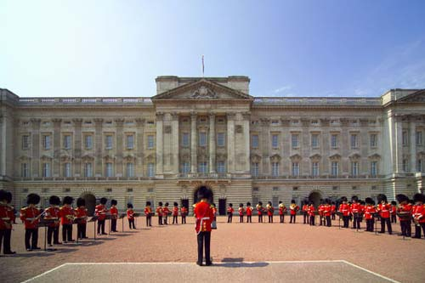
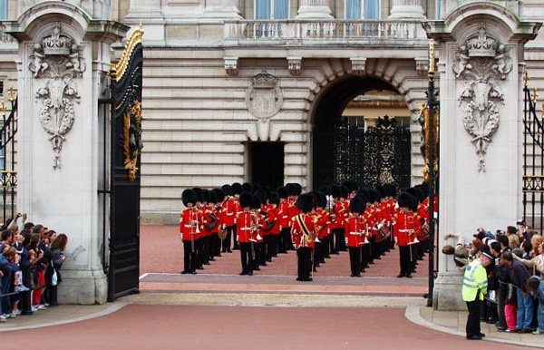
England
Buckingham Palace now lives in the Elbieta II

Slide 13
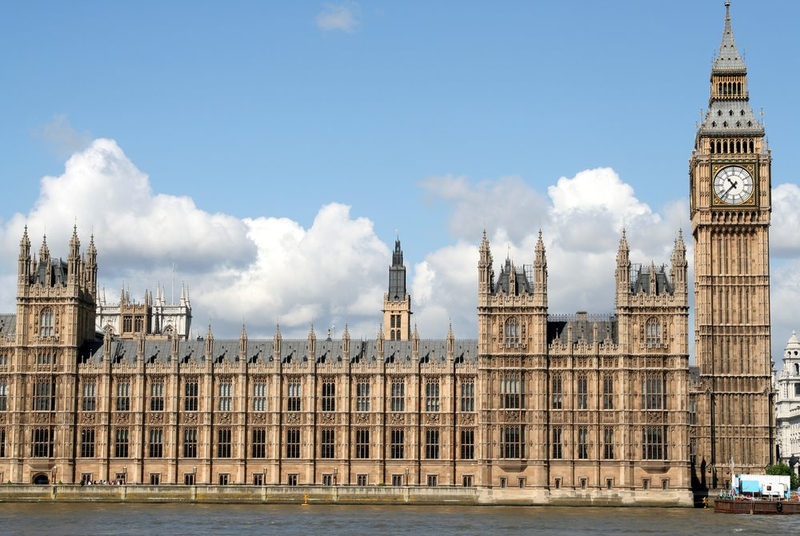
England
The Houses of Parlament

Slide 14
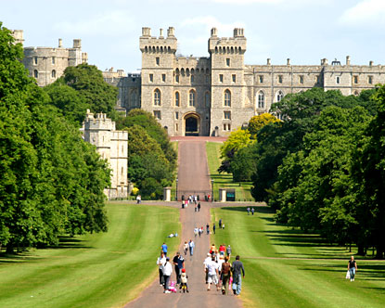
England
Windsor Castle

Slide 15
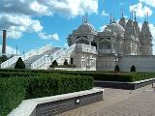
England
London Mandir Shri Swaminarayan Mandir

Slide 16
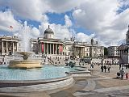
England
Trafalgar Square is a public space and tourist attraction
Central London.

Slide 17
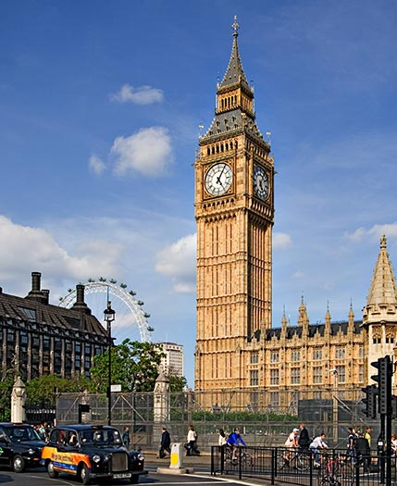
England
Big Ben is the name of a bell weighing 14 tons mounted on top of the 106 meter high tower.

Slide 18
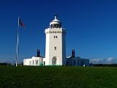
England
South Foreland Lighthouse inDover

Slide 19
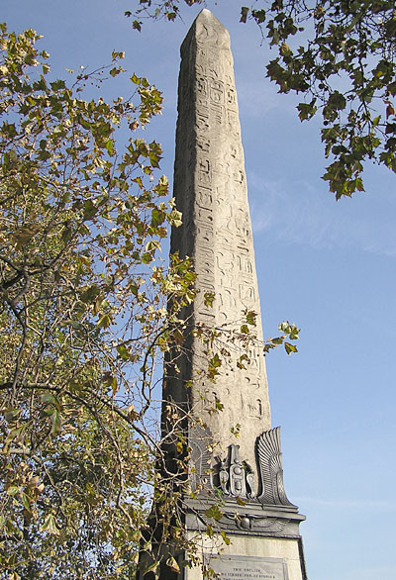
England
Cleopatra's Needle

Slide 20
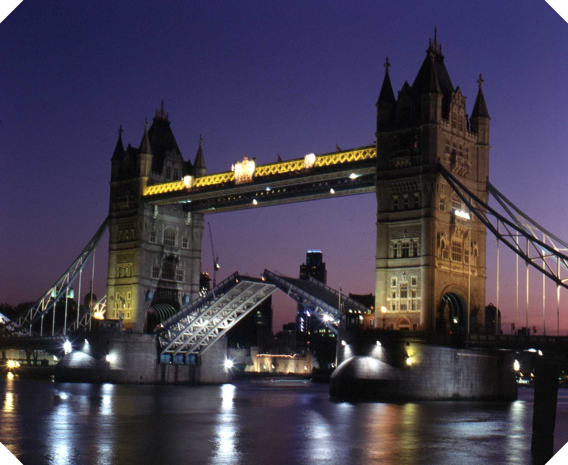
England
Tower Bridge drawbridge

Slide 21
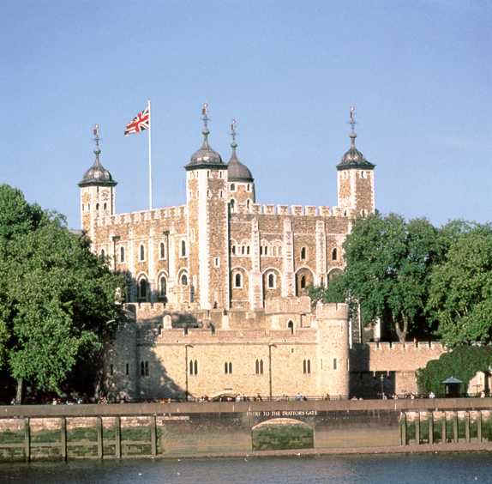
England
Tower of London

Slide 22
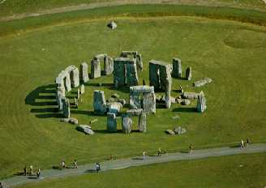
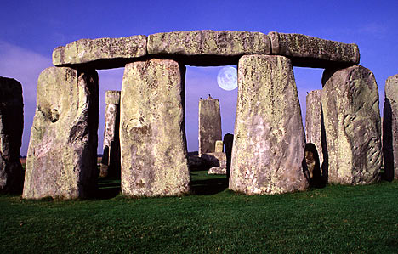
England
Stonehenge

Slide 23
England
Windsor Castle

Slide 24
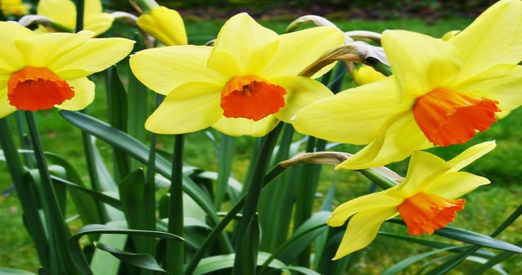
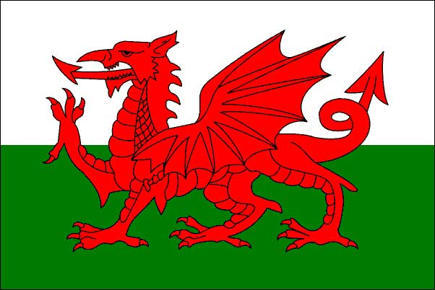
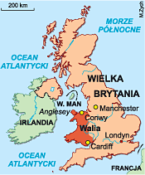
Wales
population: 3.064 million (2011)
Capital: Cardiff
National Anthem: National Anthem of Wales
Currency: Pound Sterling
Government: Devolution, Constitutional monarchy
Patron Saint. David

Slide 25
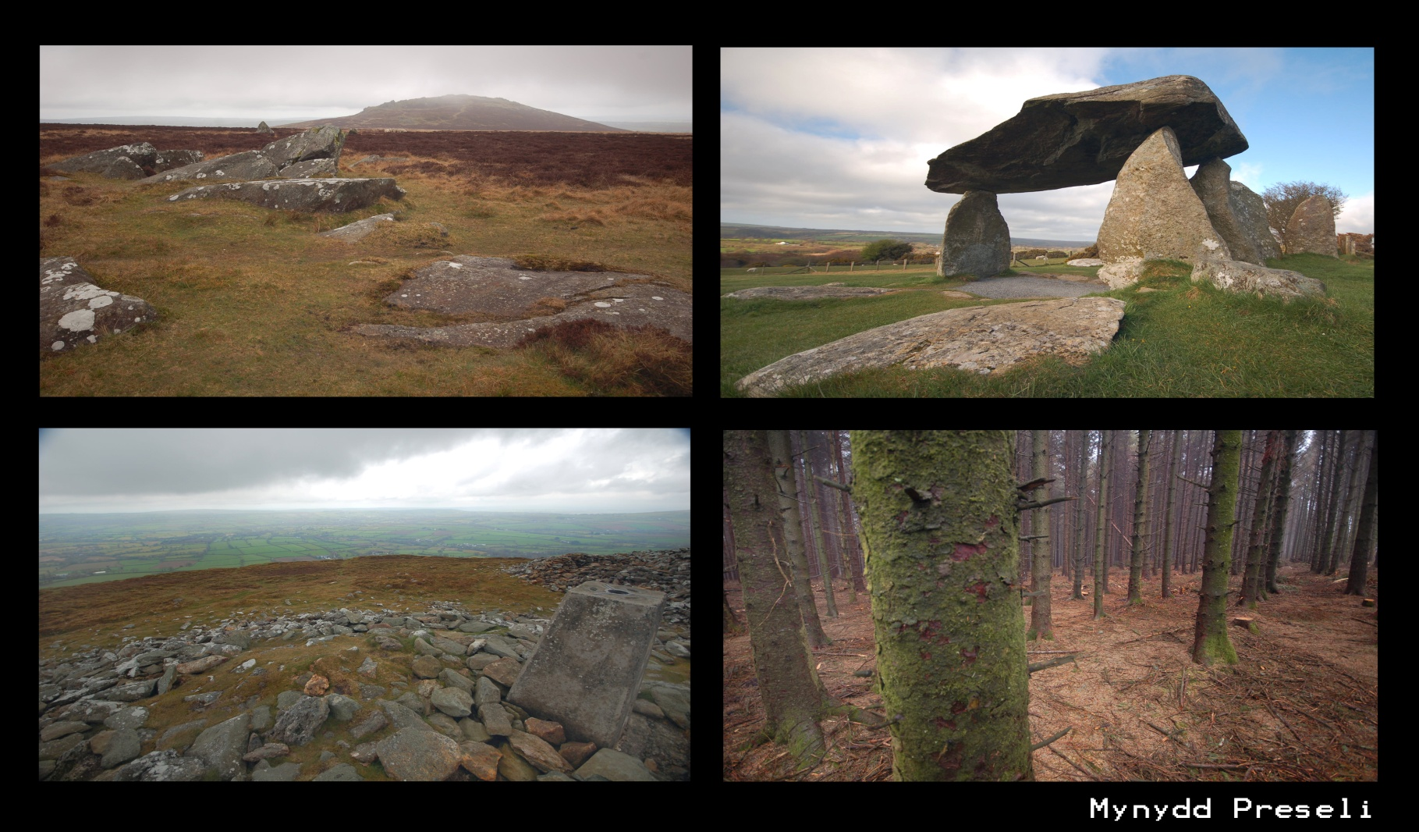
Wales
Pentre Ifan BuriaChamber

Slide 26
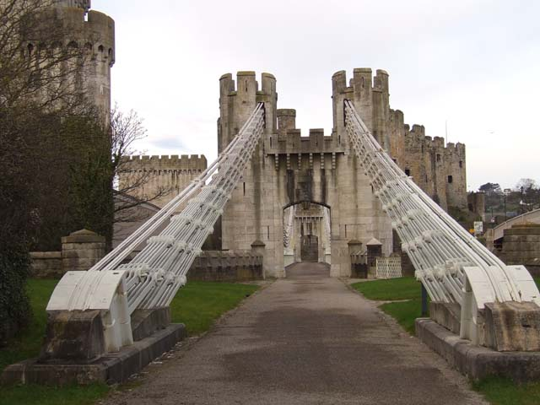
Wales
Conwy Castle. Conwy Castle. Most deceiving leading to the castle

Slide 27
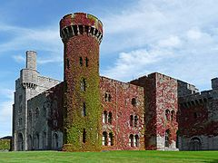
Wales
Penrhyn Castle

Slide 28
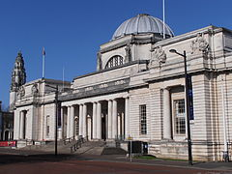
Wales
Amgueddfa Genedlaethol Caerdydd National Museum Cardiff

Slide 29
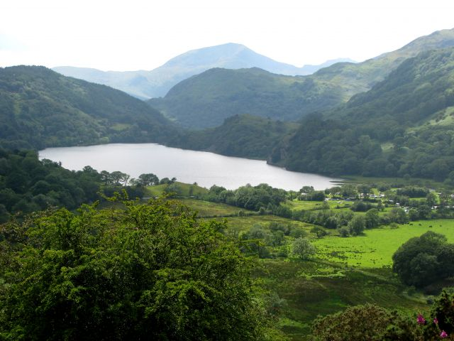
Wales
Snowdonia National Park

Slide 30
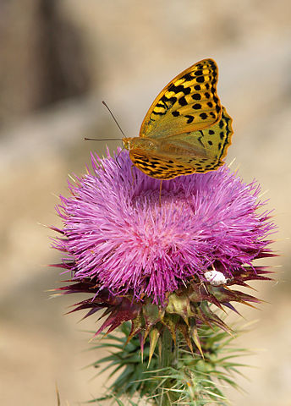
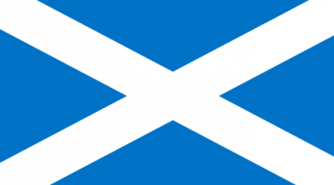
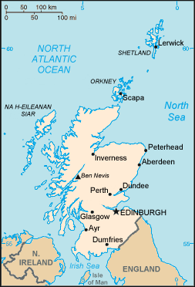
Scotland
Population: 5.295 million (2011)
Capital: Edinburgh
National Animal: Unicorn
Currency: Pound Sterling
National anthem: Scots Wha Hae, Scotland the Brave, Is There for Honest Poverty, Highland Cathedral, Scotland Anthem
Patron Saint. Andrew

Slide 31
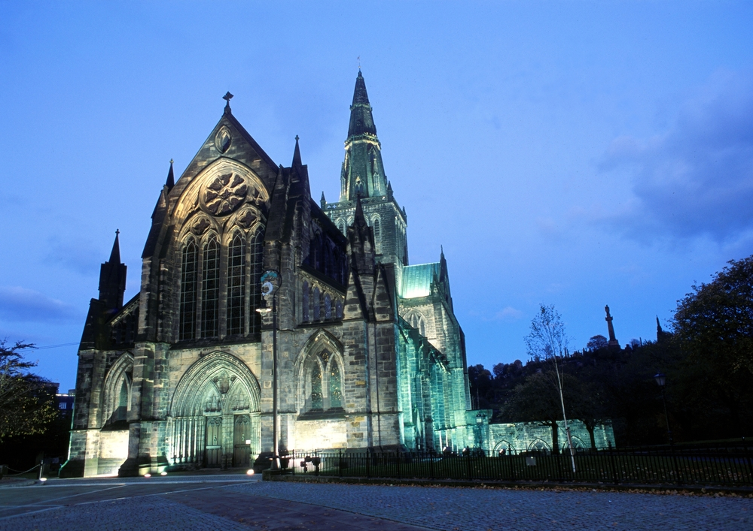
Scotland
GLASGOW CATEDRAL

Slide 32
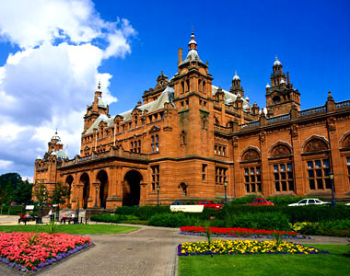
Scotland
Kelvingrove Art Gallery and Museum

Slide 33
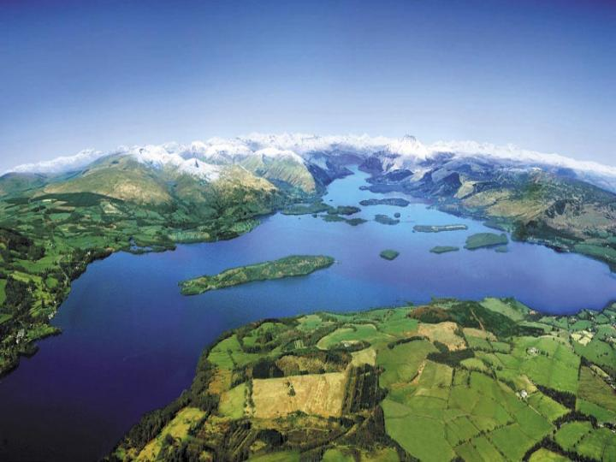
Scotland
Loch Lomond and the Trossachs

Slide 34
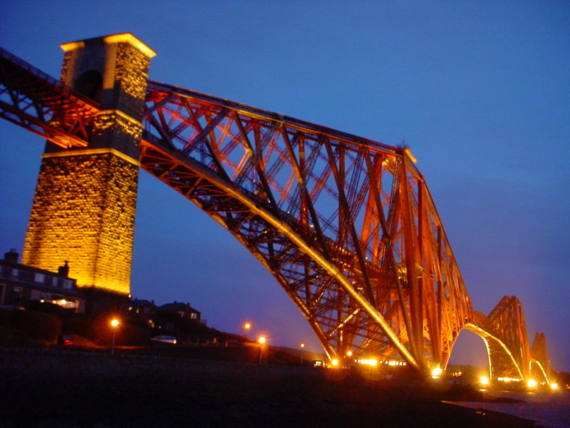
Scotland
Forth Bridge

Slide 35
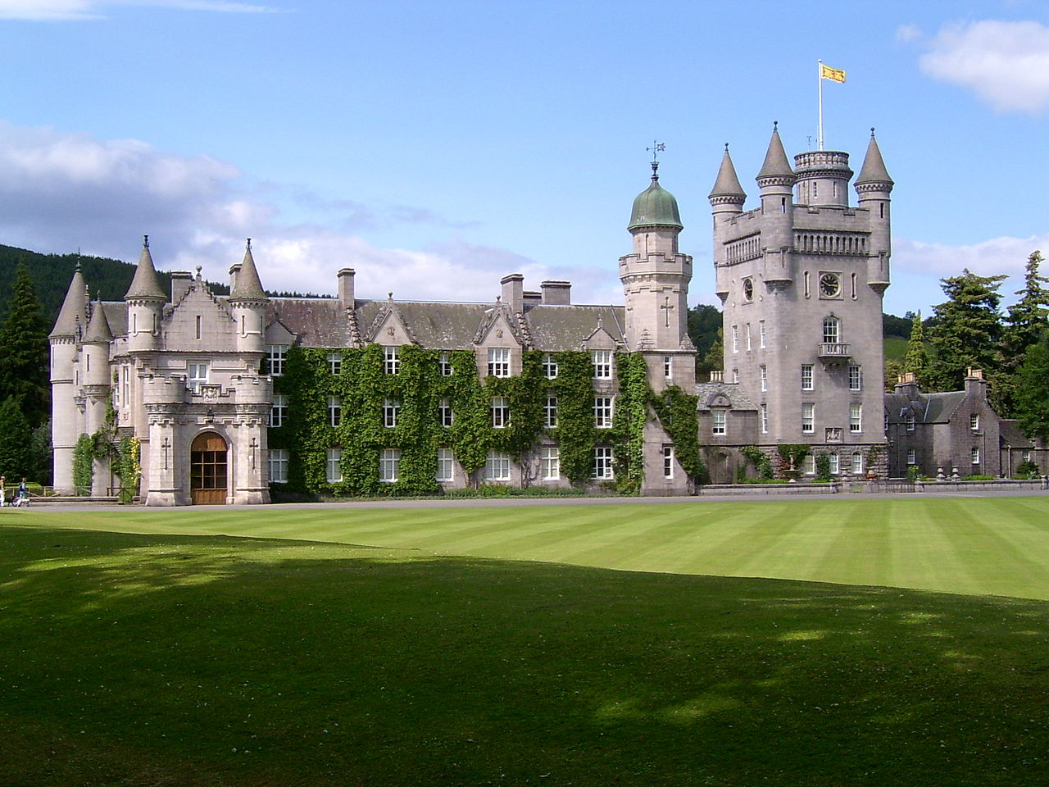
Scotland
Balmoral Castle in the National Park Cairngorns

Slide 36
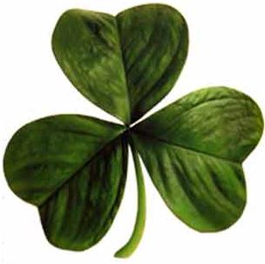

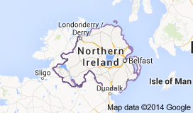
Ireland
Population: 1.811 million (2011)
Capital: Belfast
Area code: +44
Currency: Pound Sterling
National Anthem: Anthem of Great Britain
Patron Saint. Patryk

Slide 37
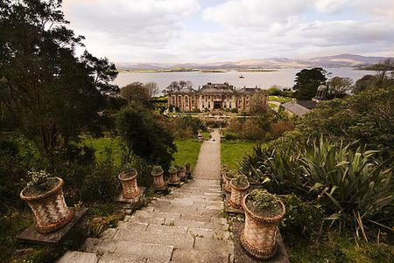
Ireland
Bantry House

Slide 38
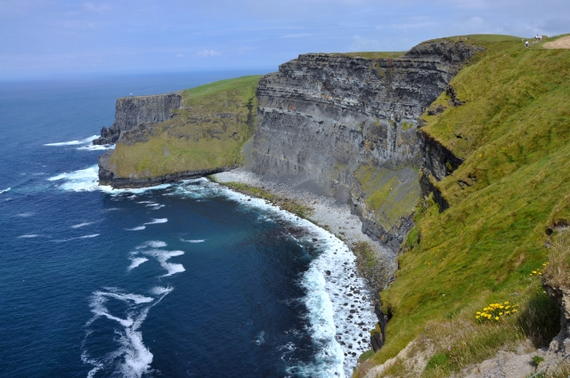
Ireland
Tombs of Newgrange

Slide 39
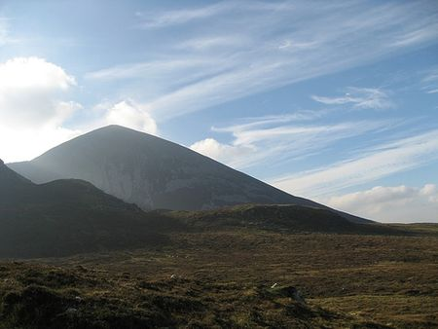
Ireland
Croagh Patrick

Slide 40
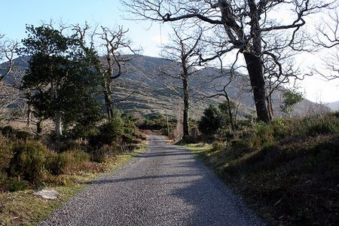
Ireland
Killarney National Park

Slide 41
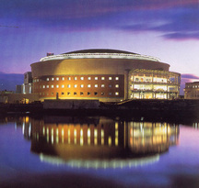
Ireland
Waterfront Hall

Slide 42
Someday I will be there….
Jakub Leszczyński kl. VB

