Slide 1

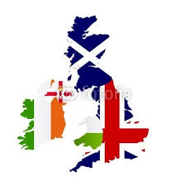
THE JOURNAY TO GREAT BRITAIN
by Łukasz Jarzyna
V „c”

Slide 2
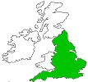
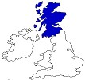
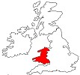
What is Great Britain?
Great Britain is the official name given to the two kingdoms
of England
and Scotland
and the principality of Wales
What is Britain?
Britain comprises only England and Wales

Slide 3
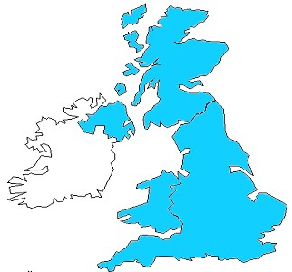
The United Kingdom
The name United Kingdom refers
to the union of four separate countries:
England, Scotland, Wales
and Northern Ireland.
UK is a member of the European Union.
Although UK do not use the Euro.
The British currency is the pound sterling.
The sign for the pound is ₤
GBP Great British Pound is made up
of 100 pence.

Slide 4
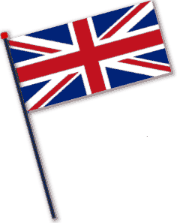
BRITISH FLAG
The Union Flag, popularly known as the Union Jack, is the national flag of the United Kingdom
A flag containing of three older national flags: the red cross of St George of the Kingdom of England, the white saltire of St Andrew for Scotland and the red saltire of St Patrick to represent Ireland.

Slide 5
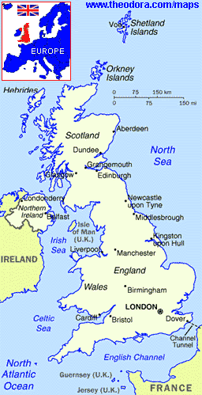
THE LARGEST ISLAND IN EUROPE
Great Britain is surrounded by seas on all sides and is separated from the European continent by the North Sea and the English Channel.
It is just 1,000 kilometres from the south coast to the far north and just under 500 kilometres in the widest part.
No place in Great Britain is more than 120 kilometres from the sea.
The main mountain regions are the Cornish Heights, the Cambrian in Wales, the Cambrian Mountains (in Lake District) and the Pennies. The highest mountain in Great Britain is Ben Nevis in Scotland.
Among the most important rivers is the Thames, which flows into the North Sea. Its length is 336 km and it is the deepest rive in Britain. The longest river in Britain is the Severn.

Slide 6
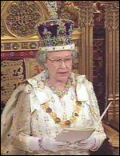
GOD SAVE THE QUEEN!
'Elizabeth the Second, by the Grace of God of the United Kingdom
of Great Britain and Northern Ireland'
Monarchy is the oldest form of government in the United Kingdom.
Her Majesty does not 'rule' the country, but she carries out a great many important tasks on behalf of the nation.
Queen Elizabeth II is a monarch since 6 February 1952
The Queen is also the Head of the Armed Forces.
Queen is Head of the Church of England

Slide 7
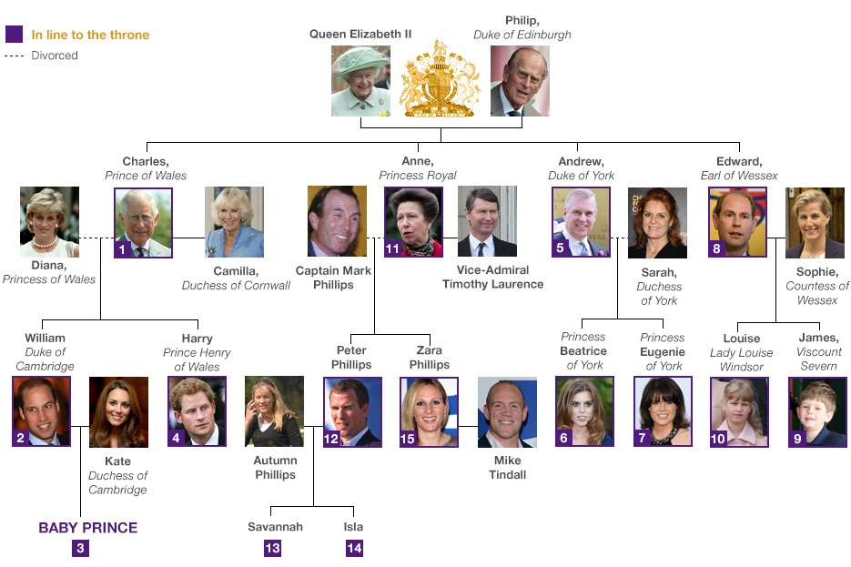
THE BRITISH ROYAL FAMILY

Slide 8
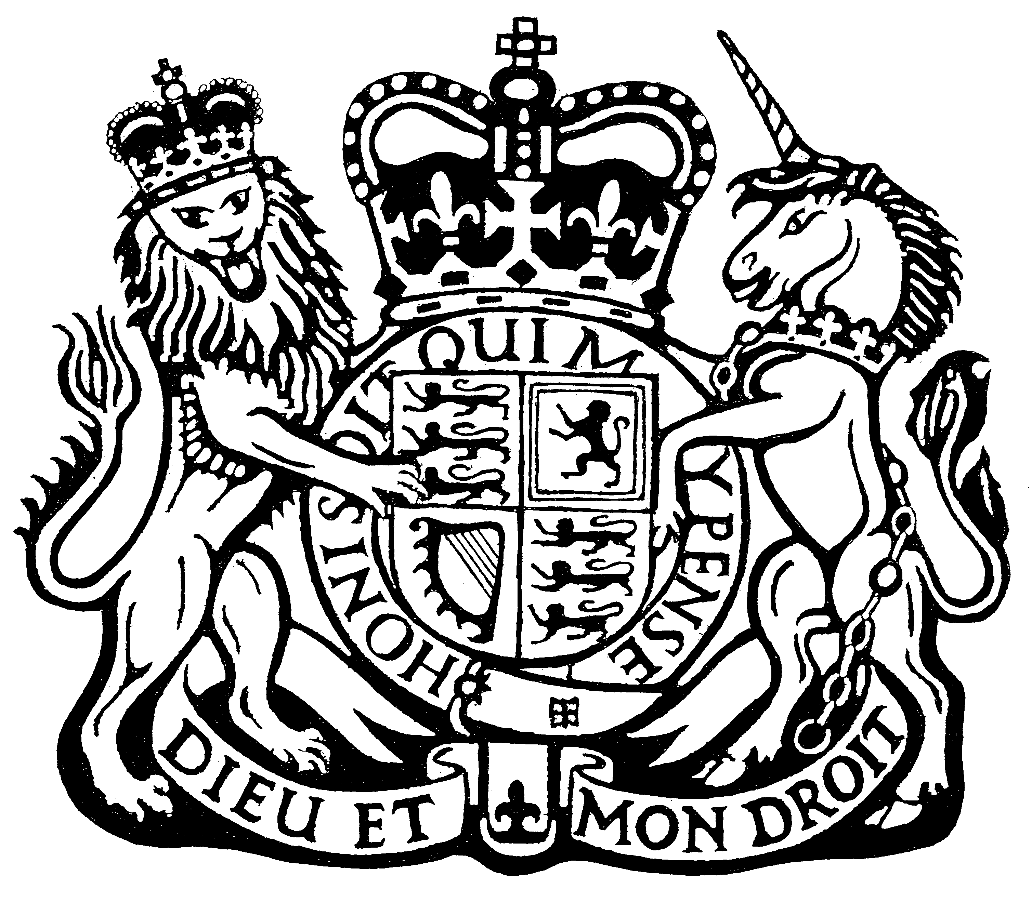
SYMBOLS OF THE MONARCHY
The Official Coat of Arms of the United Kingdom of Great Britain and Northern Ireland
On the left, the shield is supported by the English Lion.
On the right it is supported by the Unicorn of Scotland
The coat features both the motto of British Monarchs: Dieu et mon droit (God and my right)
The main element of the Arms is the shield which is divided into four quarters. The first and fourth quadrants represent England, the second quadrant represents Scotland and the third quadrant represents Ireland . There isn’t shield for Wales

Slide 9
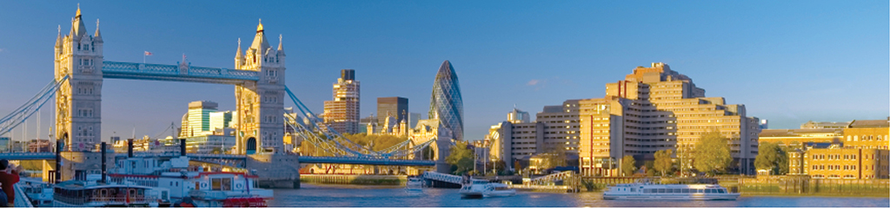
THE GREAT CITY OF LONDON
The capital and largest city, is in
the southeast and is situated at
both sides of the River Thames
English kings and queens have lived
in London for almost 1,000 years.
Is made up of two ancient cities:
the City of London, know simply as 'the City' which is the business and financial heart of the United Kingdom;
the City of Westminster, where Parliament and most of the government offices are located.

Slide 10
FASCINATING FACTS ABOUT LONDON
London is the biggest city in Europe
It occupies over 620 square miles
London has a population of 7,172,036
It was the first city in the world to have an underground railway ‘Tube’
London is the first city to host the Olympics three times (1908, 1948, 2012).

Slide 11
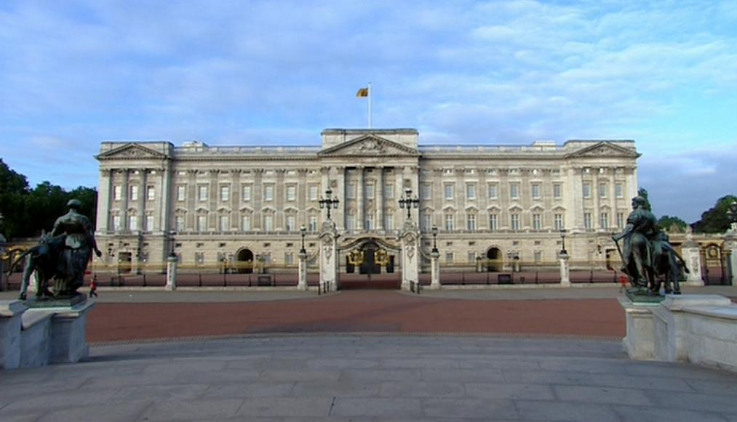
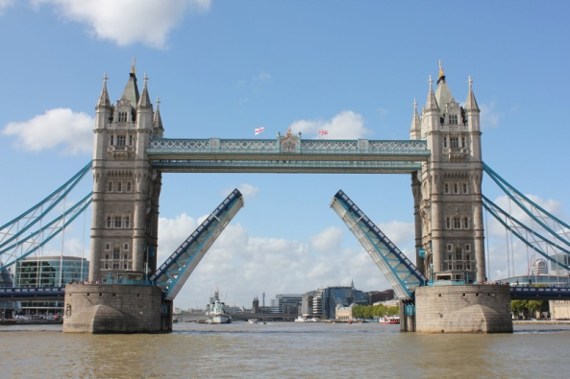
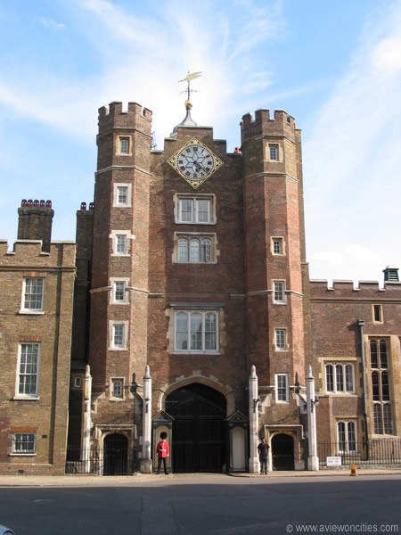
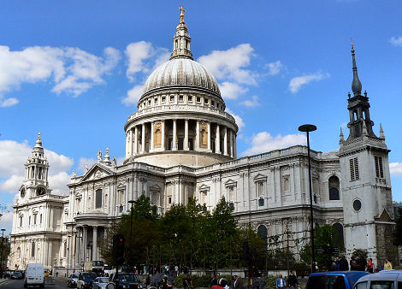
BUILDINGS AND LANDMARKS OF LONDON
Buckinham Palace is where the Queen lives.
Tower Bridge is the most recognisable bridge
St. James's Palace is one of London's oldest palaces.
St Paul's Cathedral

Slide 12


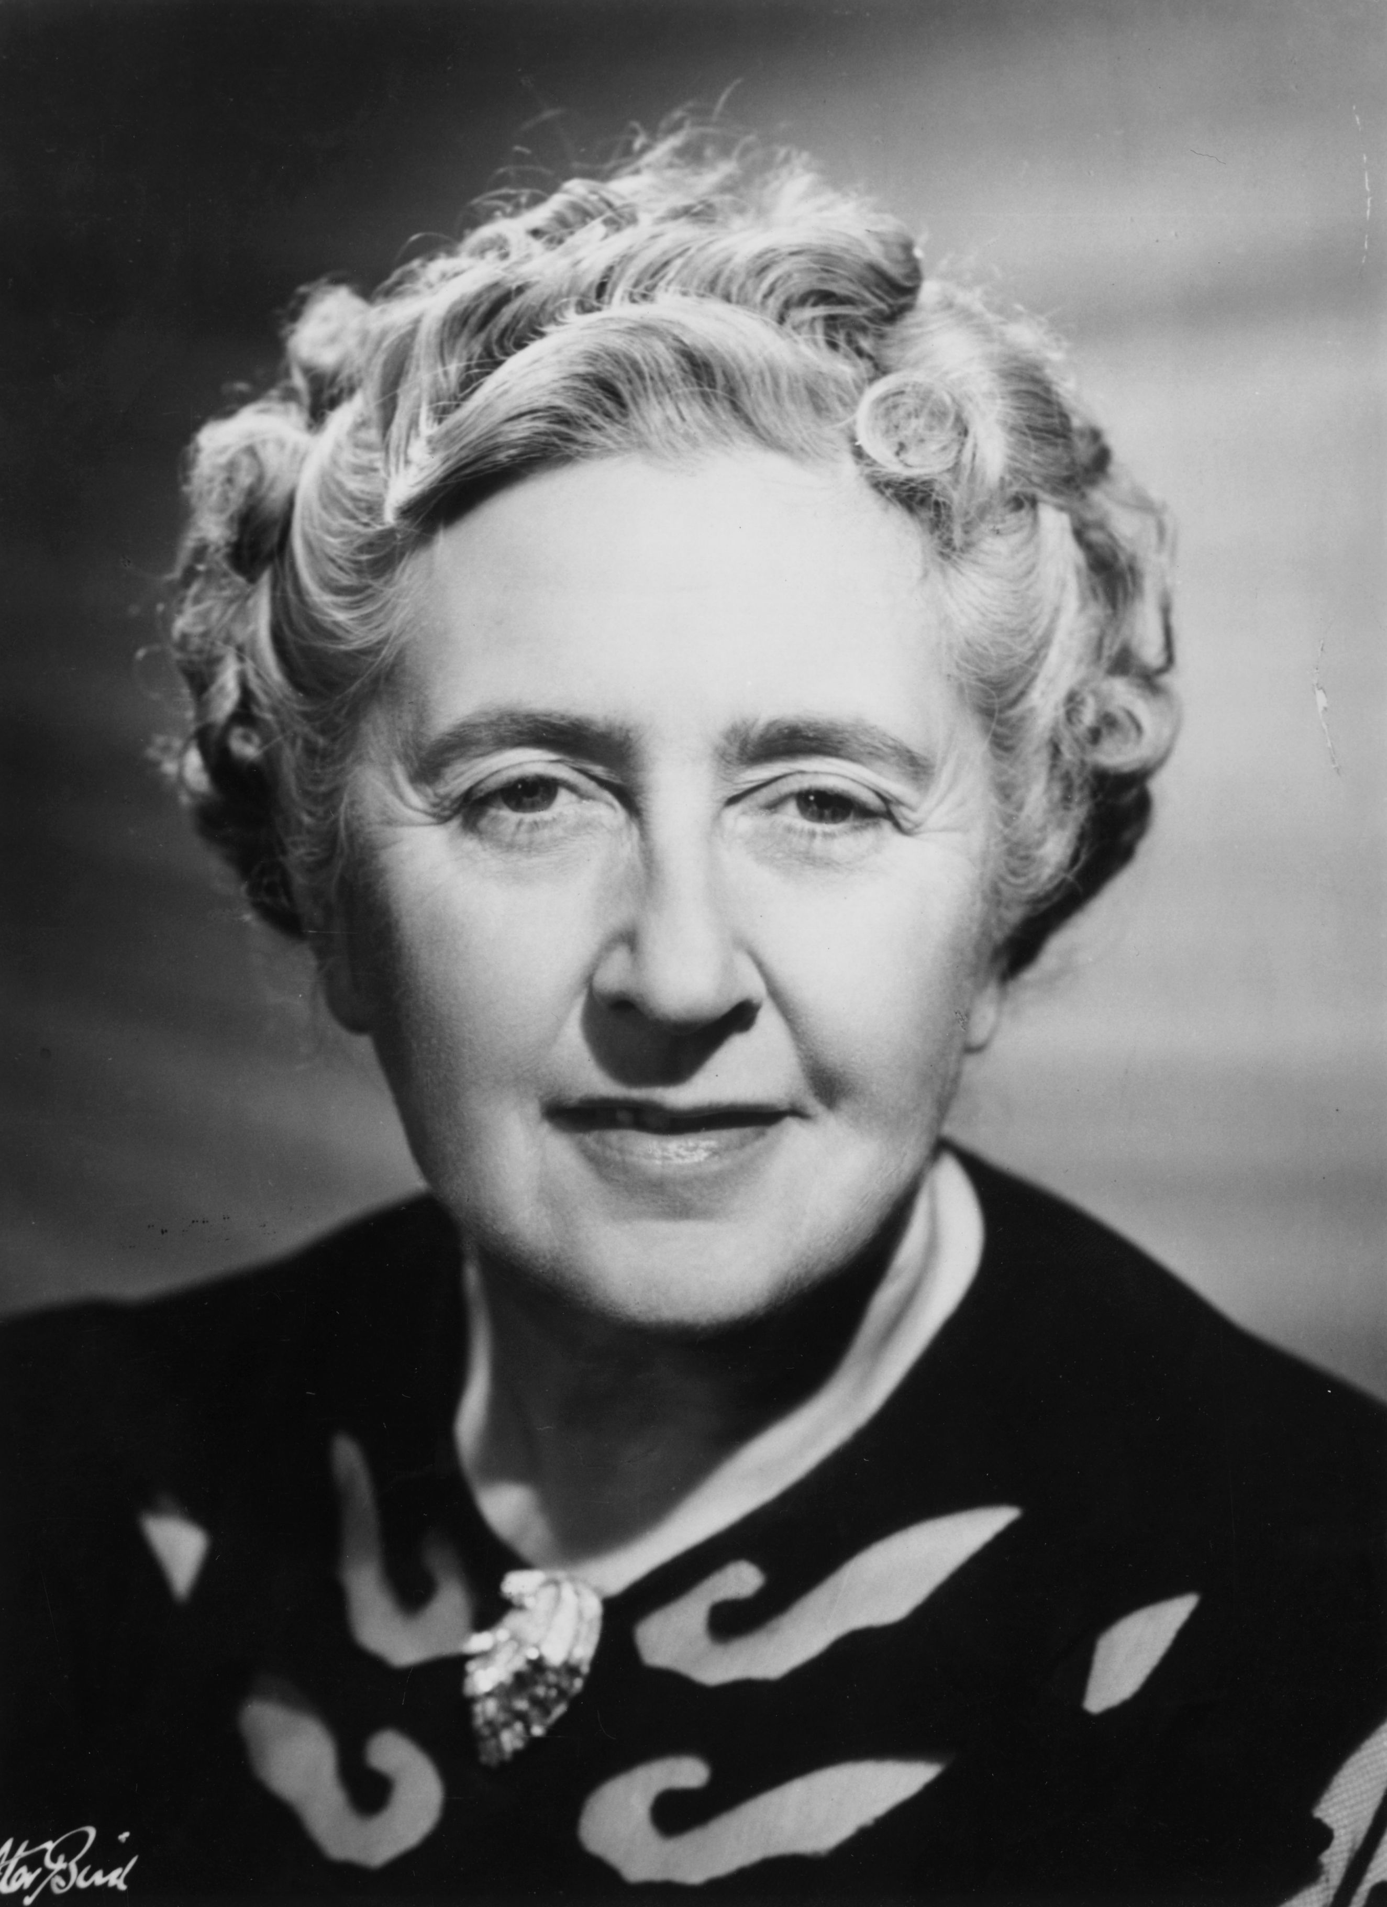
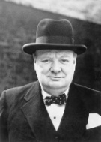
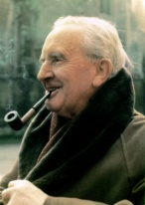
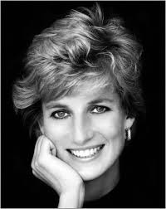
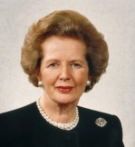
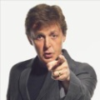
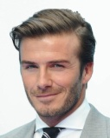
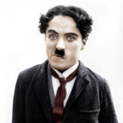
FAMOUS BRITISH PEOPLE
Famous writers and poets:
William Shakespeare
  Agatha Christie
J. R. R. Tolkien
Famous kings and politics:
Queen Elizabeth I
  Sir Winston Churchill
Diana, Princess of Wales
Margaret Thatcher
Famous sportsmen and musicians:
Sir Paul McCartney
    David Beckham
        Sir Charlie Chaplin

Slide 13
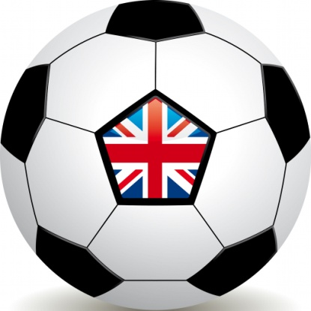
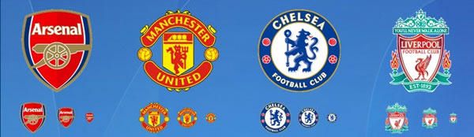
Score the goal!
Football is most popular sport in UK.
Some of England's football teams are world famous.
The most famous team is Manchester United, Arsenal, Chelsea and Liverpool.

Slide 14
British have a fun!
There are a lot of unusual Customs and Traditions in Great Britain.
Twelfth Night (5th January) is when all Christmas Decorations should be removed so as not to bring bad luck upon the home.
Pancake Races
Pancake races are held all over England on or near Shrove Tuesday.
Easters : Egg Jarping Egg Rolling, special chocolate presents for children
Well-Dressing Derbyshire on May
The ancient Horn Dance is an annual event held traditionally on the first Monday after the first Sunday after September 4th!
Huge cheese hurtle down a steep slope, pursued by dozens of running, rolling competitors, the fastest of whom wins the cheese – this is cheese rolling!.
Mummers' Plays are one of the oldest surviving features of the traditional English Christmas
Bonfire Night on and around the 5 November

Slide 15
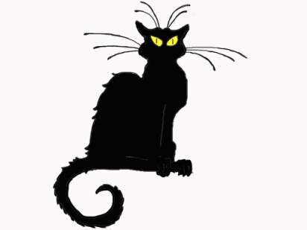
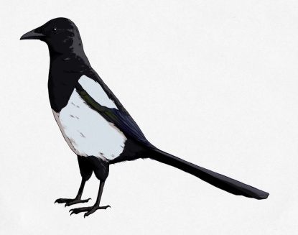
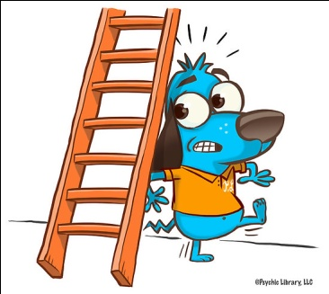
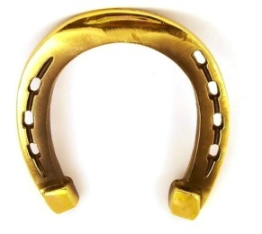
Superstitions in Britain
Good Luck is to:
Unlucky is to
meet a black cat
find a clover plant with four leaves
walk underneath a ladder
see one magpie
open an umbrella in doors
put new shoes on the table
Putting money in the pocket of new clothes
On the first day of the month it is lucky to say white rabbits, white rabbits, white rabbits,

Slide 16
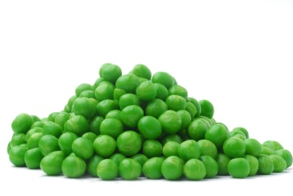
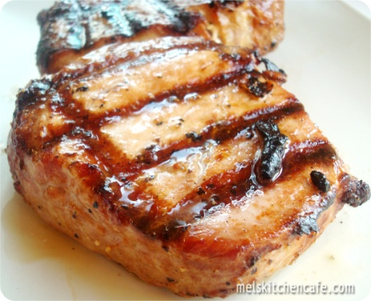
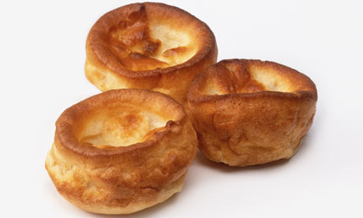
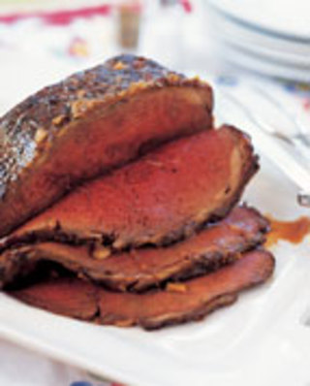
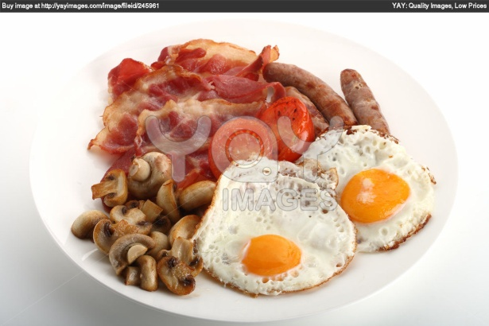
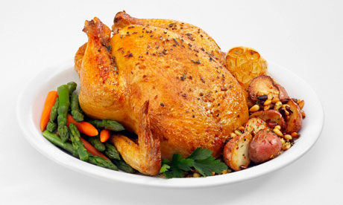
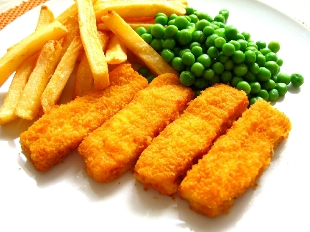
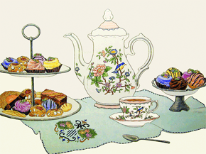
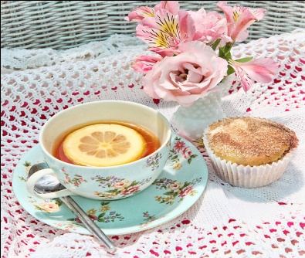
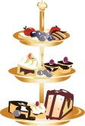
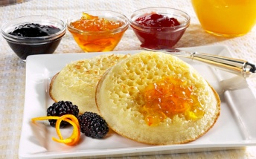
IT’S TIME TO EAT!
"Harry’s mouth fell open. The dishes in front of him were now piled with food. He had never seen so many things he liked to eat on one table: roast beef, roast chicken, pork chops and lamb chops, Yorkshire pudding, peas, carrots, gravy, ketchup and, for some strange reason, mint humbugs."
Harry Potter and the Philosopher’s Stone, J. K. Rowling
AFTERNOON TEA
the traditional 4 o'clock tea
HIGH TEA
the traditional 6 o'clock tea

