Slide 1
My dream day at school

Slide 2
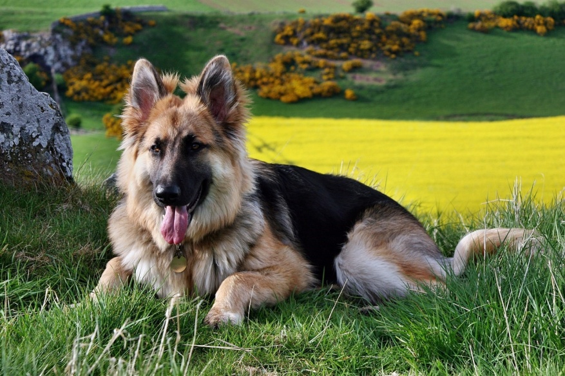
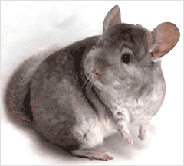
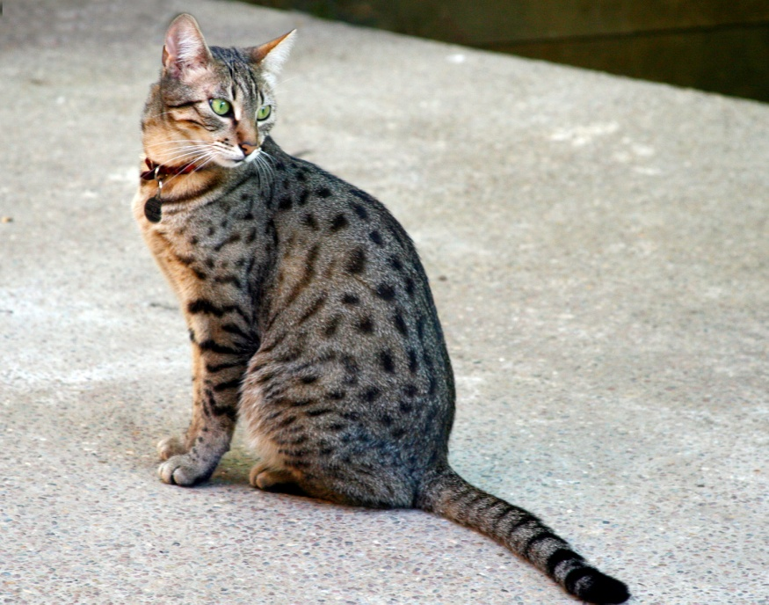
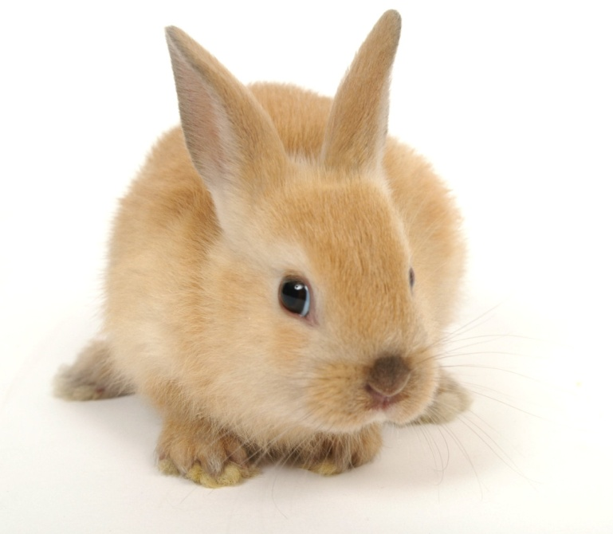
I can bring animals to school.

Slide 3
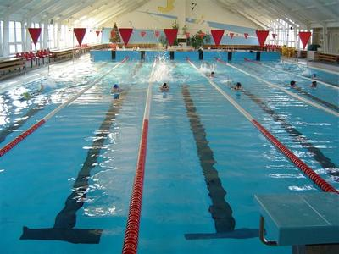
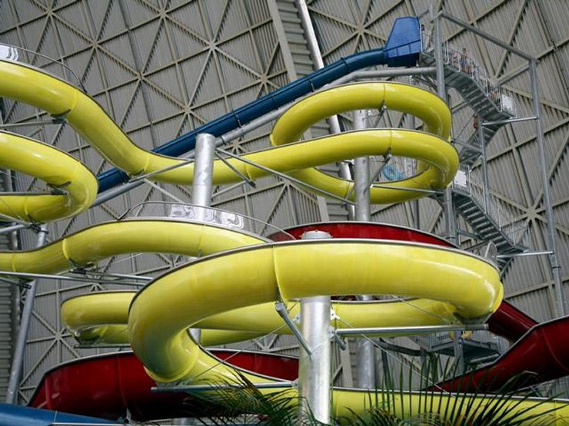
I’d like to have 2 lessons at swimming pool.

Slide 4
I’d like to have 3 English lessons

Slide 5
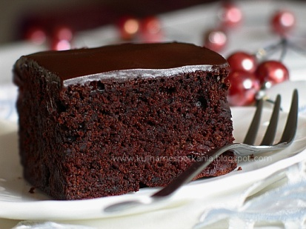
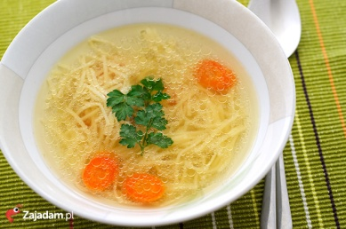
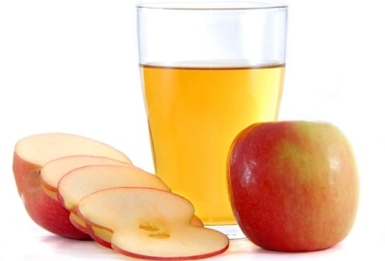
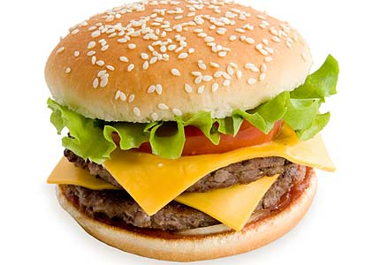
Canteen menu
Deserts:
Chocolate cake
Apple cake
Cheese cake
Big ice cream
fruit (banana,apple)
Drinks:
Apple juice
Tea
Cola
Orange juice
Rasberry juice
Starter:
Chicken soup
Tomato soup
Main course:
Spagetti
Pizza
Potato pancakes
Fish and chips
Hamburger and chips
Cheese omelette and salad

Slide 6
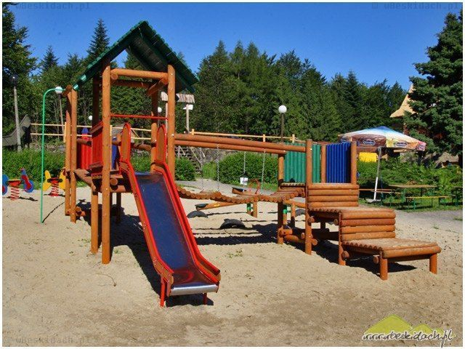
I’d like to go to the playground at p.e lesson.
AND I LIKE DODGEBALL GAME

Slide 7
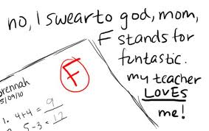
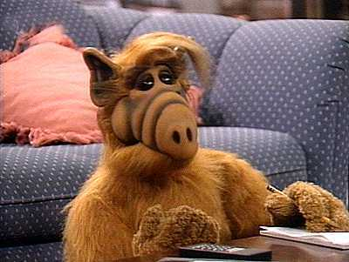
There aren’t any tests.
I'm not lazy, just doing some things do not see the point.

Slide 8
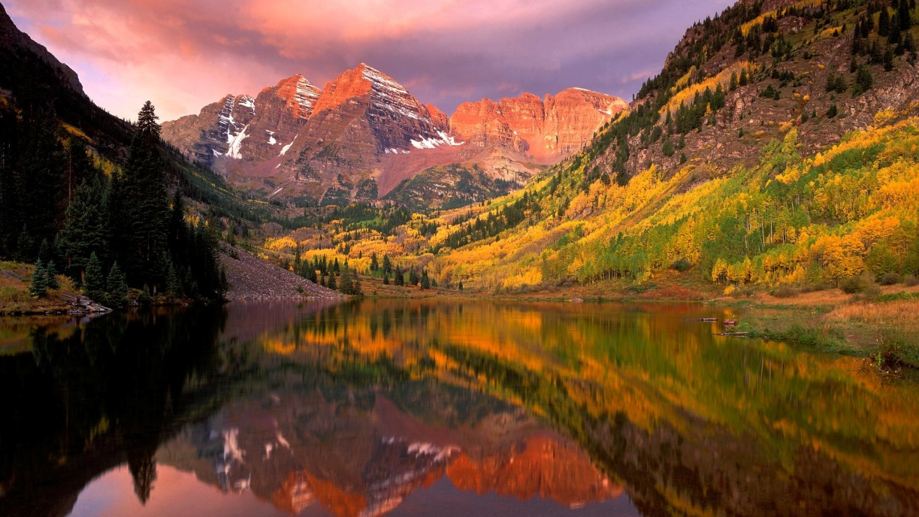
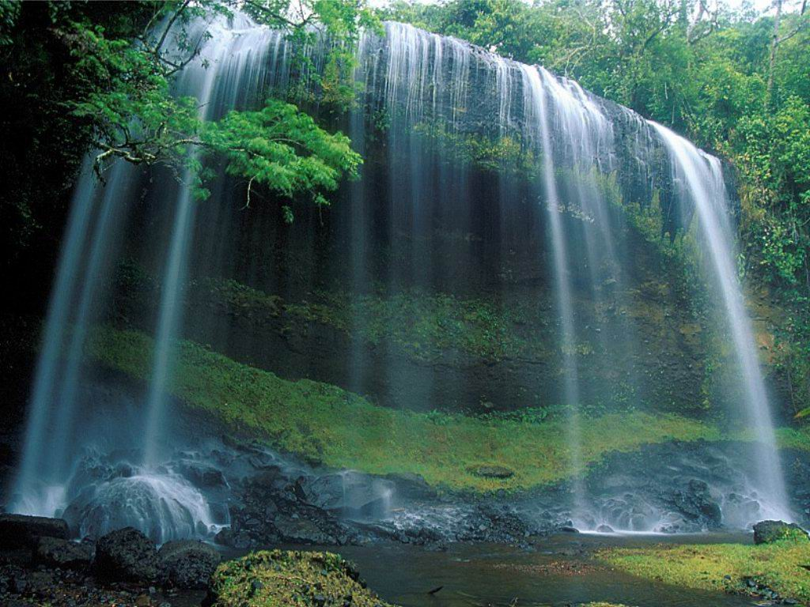
I’d like to have lesson outSIDE SCHOOL.

Slide 9
I’d lIke to have a disco AT SCHOOL.
II like to move it, move it …

Slide 10
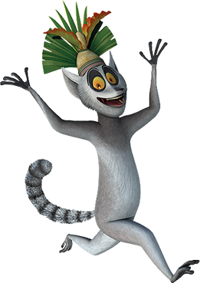
Prezentację wykonała adrianna wieleba z klasy 5b
Materiały pochodzą z internetu.
BYE, BYE …

