Slide 1
School Education Staff Mobillity
Operational Programme Knowledge Education Development 2014-2020
Project name
OPENING MINDS- TOGETHER IN EUROPE
Cofinanced by European Social Fund

Slide 2
Beginning of the project 01/09/2016
End of the project 31/05/2018
Length in months 21
Total budget 55.461,00 €
Number of mobilities – 22
Type of activity – structured courses and visits

Slide 3
What are the aims of a mobility project?
Support teachers in the acquisition of learning outcomes (knowledge, skills and competences) with a view to improving their personal development, their involvement as considerate and active citizens in society
Support the professional development with a view to innovating and improving the quality of teaching
Enhance notably the participants’ foreign languages competence;
Raise participants’ awareness and understanding of other cultures and countries, offering them the opportunity to build networks of international contacts, to actively participate in society and develop a sense of European citizenship and identity;
Increase the capacities, attractiveness and international dimension of the organisation

Slide 7
English Matters different locations
Structured Educational Visit & Training Seminar
in Málaga, Spain
CLIL: Content and Language
Integrated Learning in Dublin (Ireland)
Talking to people: Inquiry-based & Cooperative Methodology in Dublin (Ireland)
English for Teachers (A2, B1)inDublin (Ireland)
Structured Educational Visits to Schools/Institutes & Training Seminars in Iceland

Slide 8
English Language development for teachers
-Subject Specific by ALPHA SCHOOL OF ENGLISH
MALTA
General English with Using Technology and British Culture - Manchester Communicate School of English
BSC London; Intensive General English

Slide 9
IPC Exeter Better English for Teachers‘ (BET)
Teacher Academy - Europass Centro Studi Europeo Corso per insegnanti di italiano L2/LS Firenze, Italy
Chain Foundation Las otras orillas (The other
shores) Sevilla, Spain

Slide 10
Lisbon Inspiration –Intercultural Approaches
Location: Escola Básica e Secundária Passos Manuel, Lisbon, Portugal
DIC - Developing intercultural competence and learning about best practice examples to fight against racism, prejudice and discrimination in schools, La Manga, Spain Volkshochschule Schrobenhausen

Slide 11
All mentioned above actions lead to the considerable improvement in our teaching practice and in our students achievements. New knowledge is included in curriculum, and skills are applied into practice. Thanks to the European added value, the emphasis is placed on integration, fighting racism and prejudice, learning languages, gaining new intercultural experience. We have a great responsibility for the development of a new generation, we want to prepare our students for the adult life, endowed them with the ability to use foreign languages, adapt to changing conditions, teamwork, multiculturalism, tolerance,
open mind and self-esteem.

Slide 12
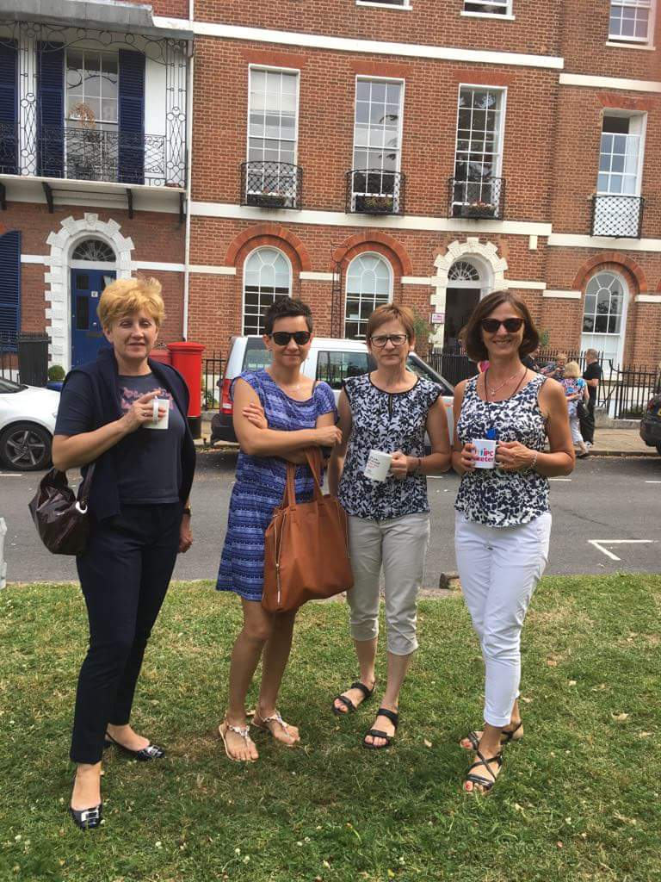
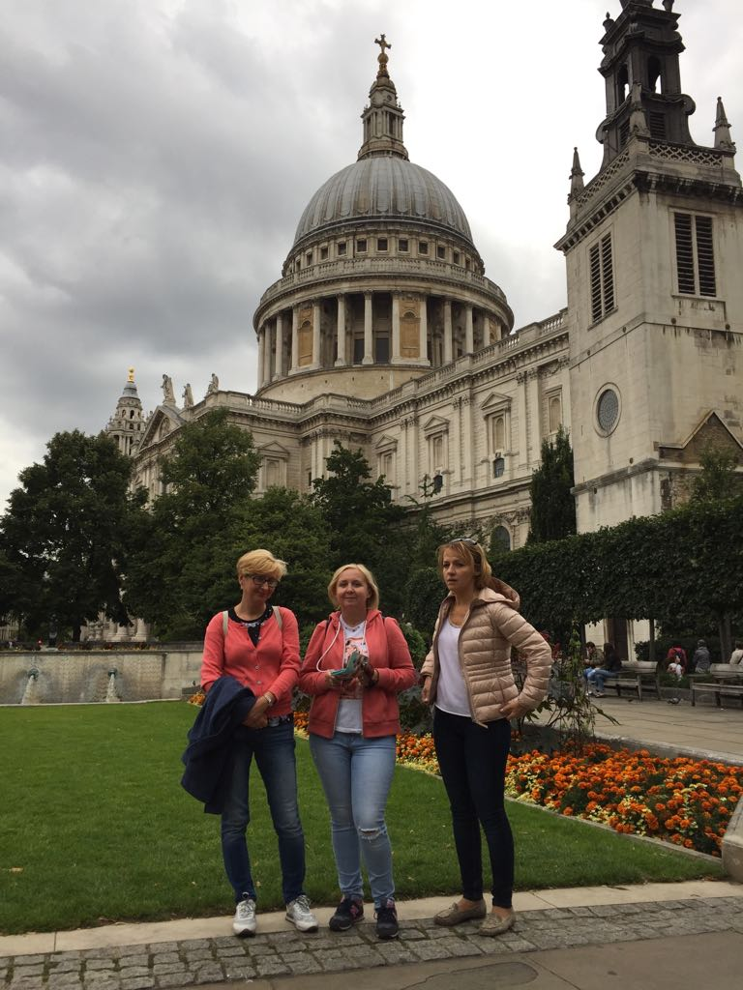

Slide 13
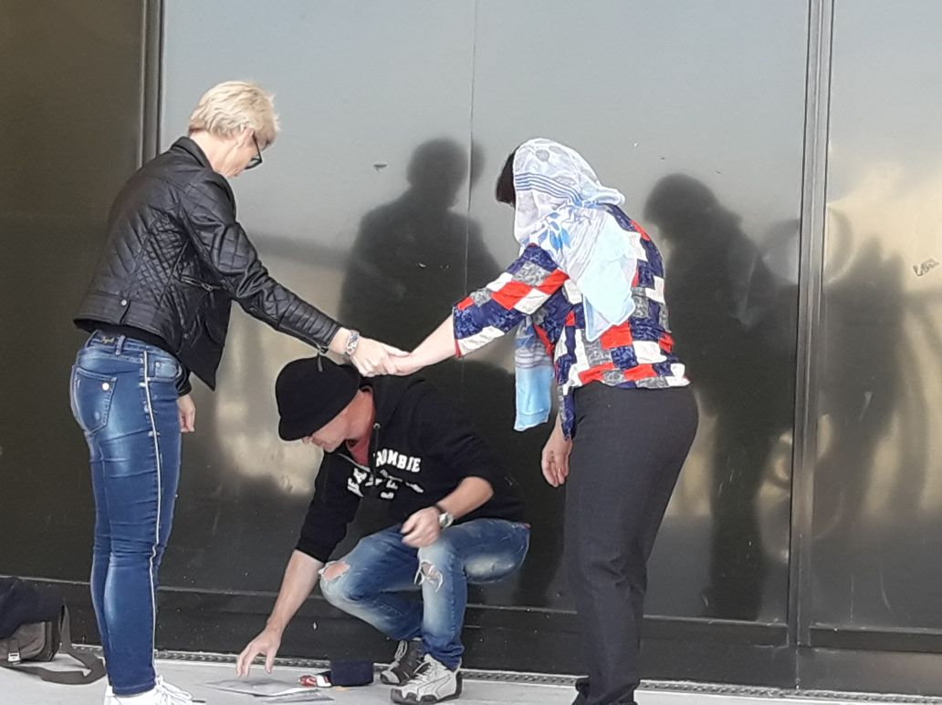
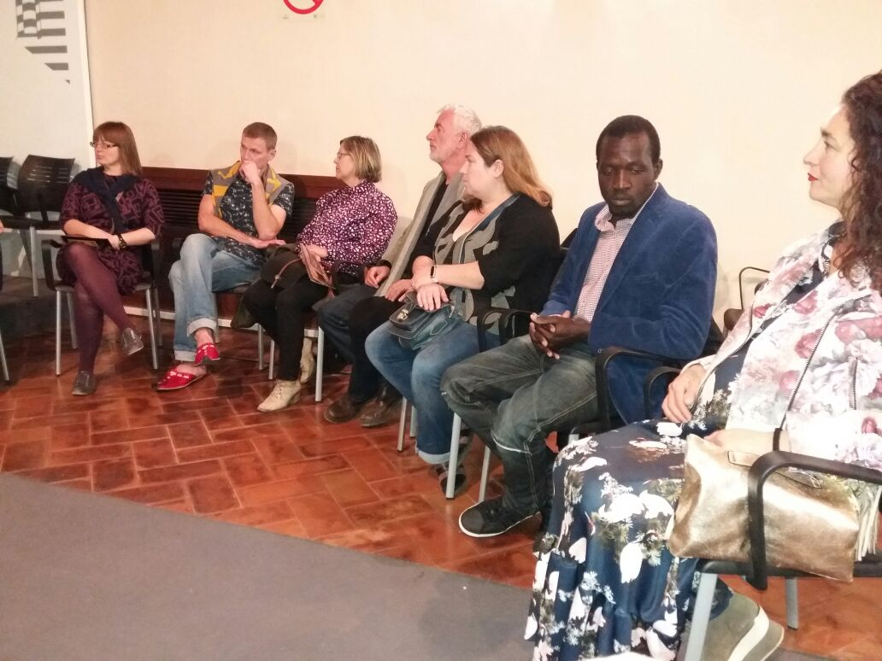
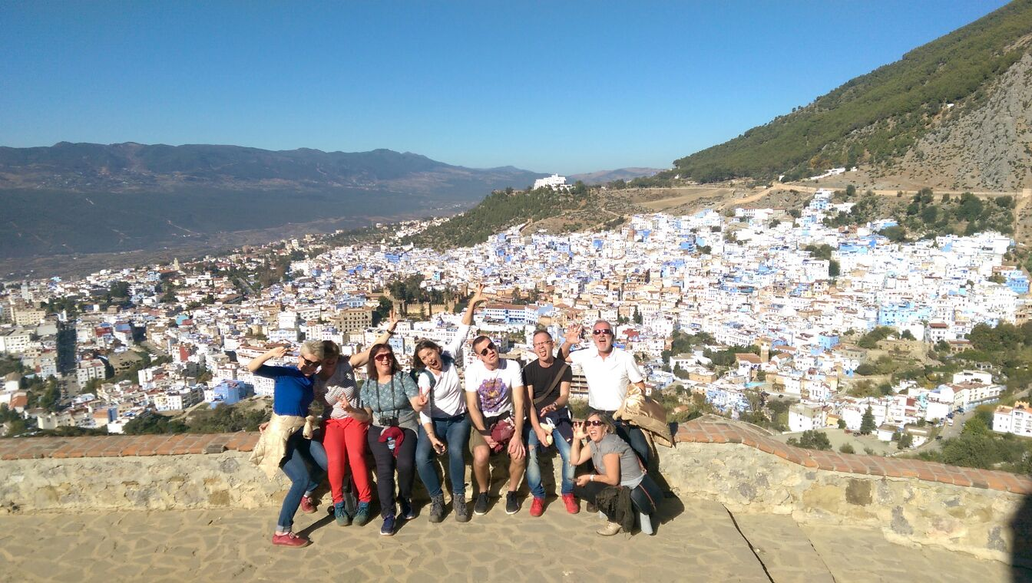

Slide 14
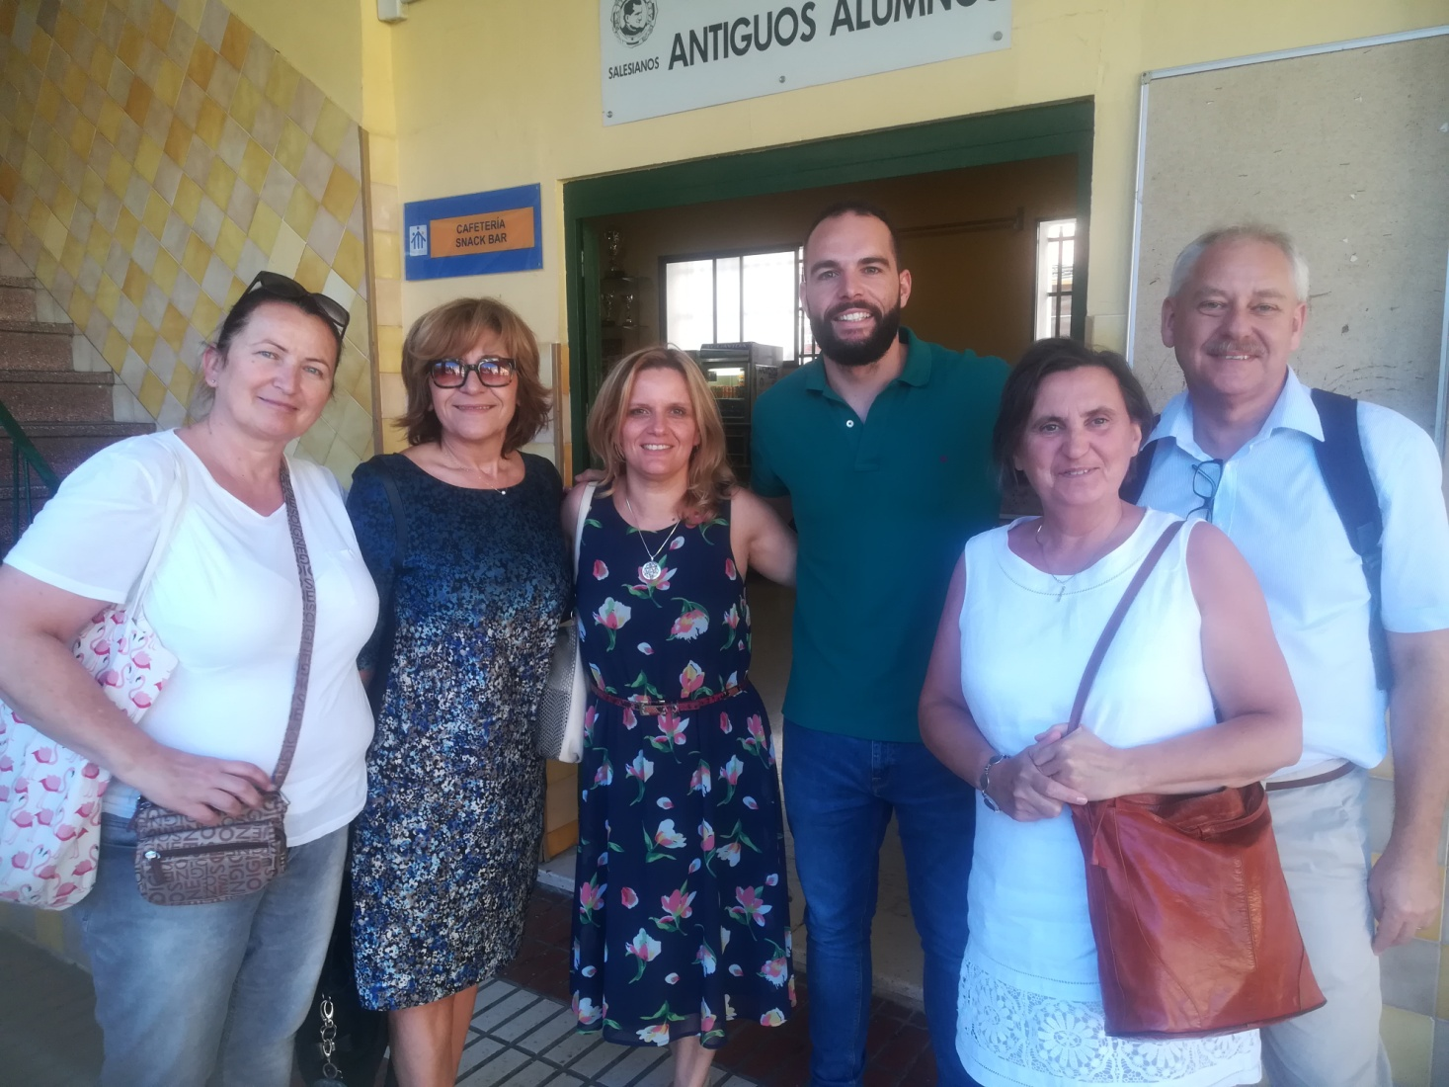
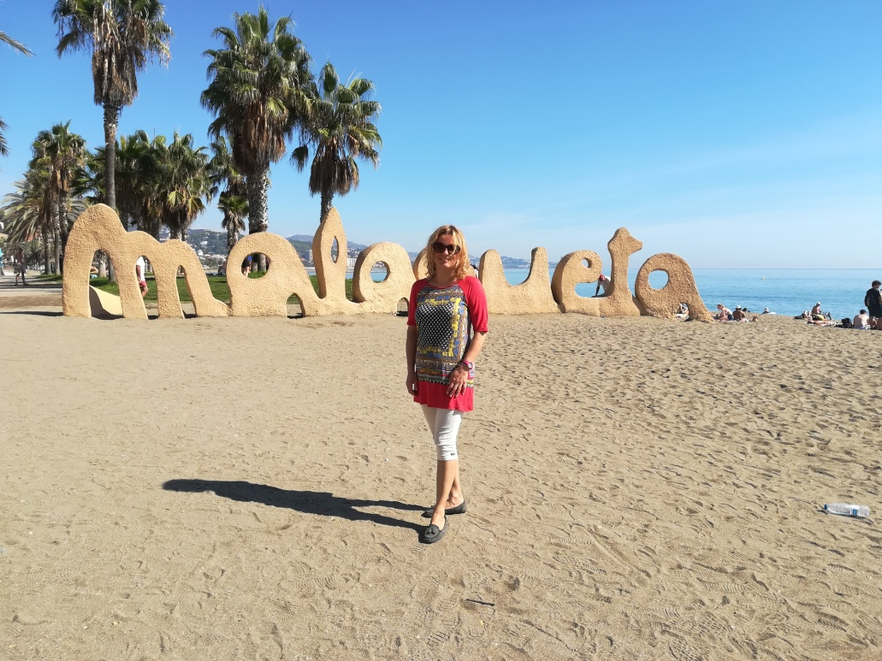

Slide 15
